Slide 1
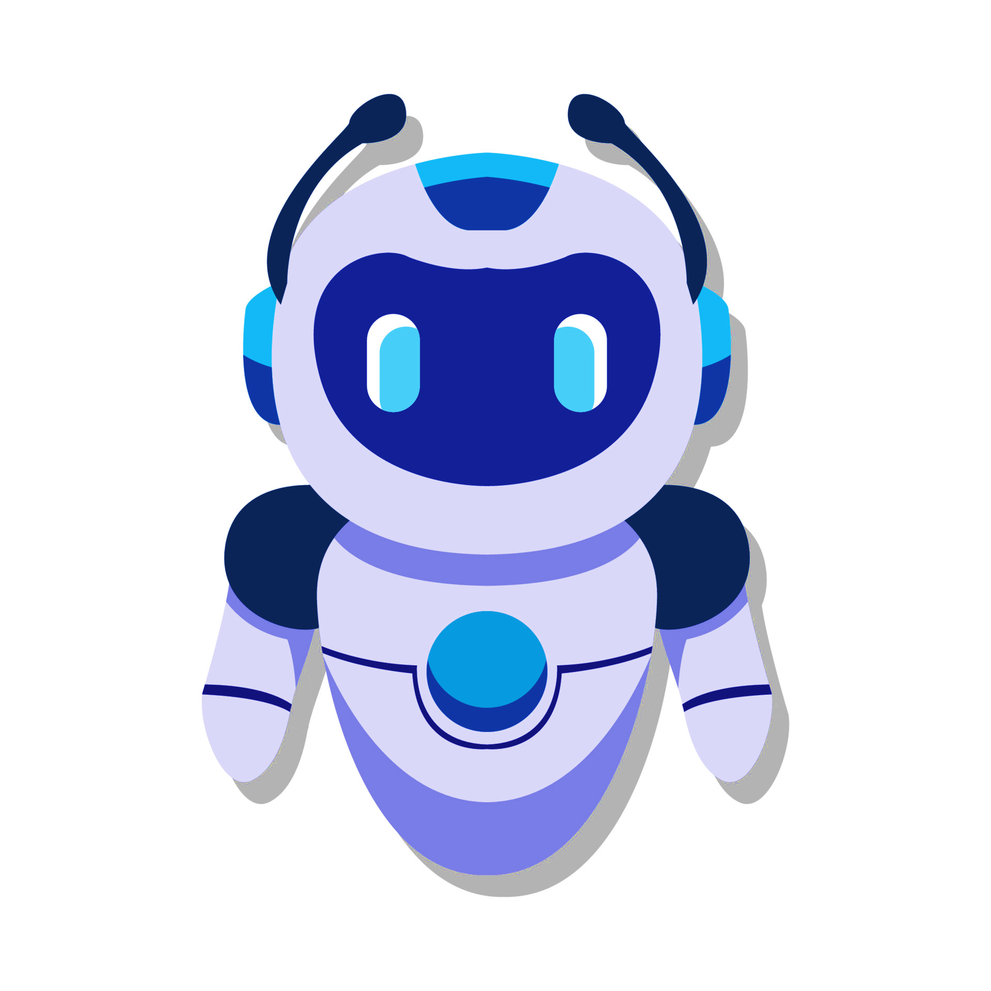
Python Chatbot

Slide 2
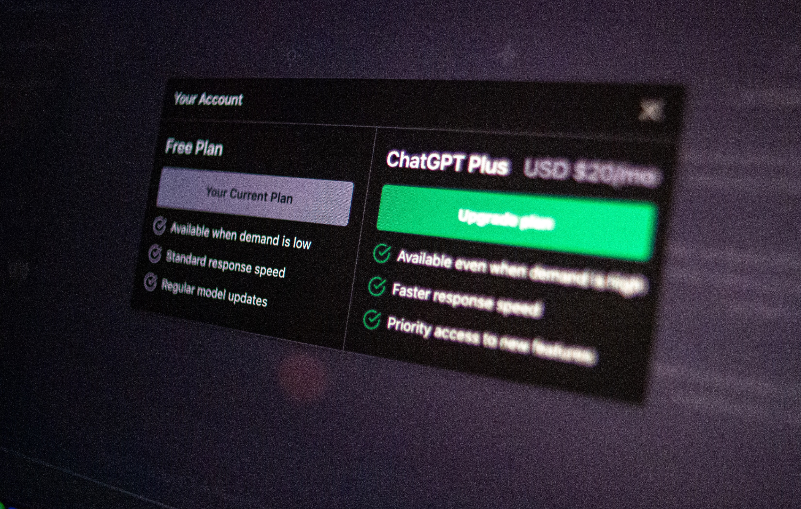
What Is a Python Chatbot?
A Python chatbot is an AI-based conversational program built using Natural Language Processing (NLP) techniques to interact with users through text.
Example interaction:
User: Hi there! Bot: Hi there, how can I help?
NATURAL LANGUAGE PROCESSING (NLP)

Slide 3
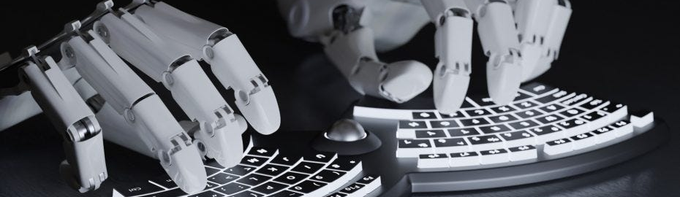
Functionality of the Python Chatbot
01
02
03
Feature Extraction:
Converts text into a numerical bag-of-words vector.
Intent Prediction:
Predicts user intent using a trained Keras neural network model.
Input Processing:
Accepts user input as text.
Tokenizes and lemmatizes it using NLTK.

Slide 4
Functionality of the Python Chatbot
04
05
Response Generation:
Matches predicted intent to pre-defined responses in intents.json.
Selects an appropriate reply at random.
Continuous Conversation:
Runs in a loop to handle real-time user queries.

Slide 5


Why Build a Python Chatbot?
1.Enhance User Interaction: Provides instant responses.
2.Hands-on NLP Experience: Great way to learn Natural Language Processing, machine learning, and text preprocessing using Python.
3.Customizable & Scalable: Easily train on custom intents and expand functionality as needed.
4.Open-source Flexibility: Leverages libraries like NLTK, TensorFlow/Keras, and Python’s ecosystem — no licensing costs.

Slide 6
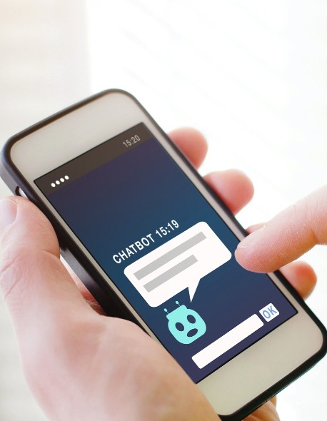
Easy to Train and Update: Add new intents and retrain the model easily using your own data.
Offline & Fully Customizable: No external APIs needed — works with local files and your custom intents.json.
Key Benefits
Fast and Lightweight: Processes inputs quickly using an efficient bag-of-words and prediction mechanism.
Accurate Intent Recognition: Uses a trained neural network model to understand user queries reliably.

Slide 7
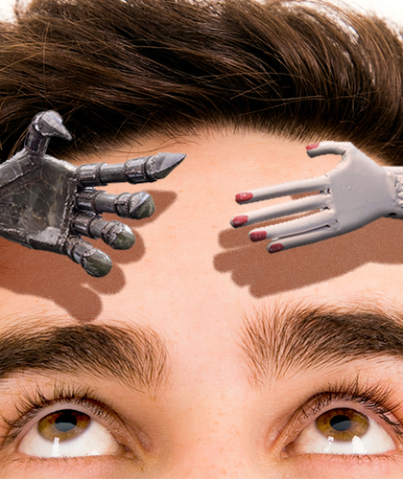
Key Features
1.
Custom Intent Data (intents.json): Easy to define and expand conversation logic through structured patterns and responses.
2.
Self-Trained Model: Model is trained locally — no internet or external services required.
3.
Simple Terminal-Based Interface: Real-time interaction in a command-line environment for testing and demos.

Slide 8
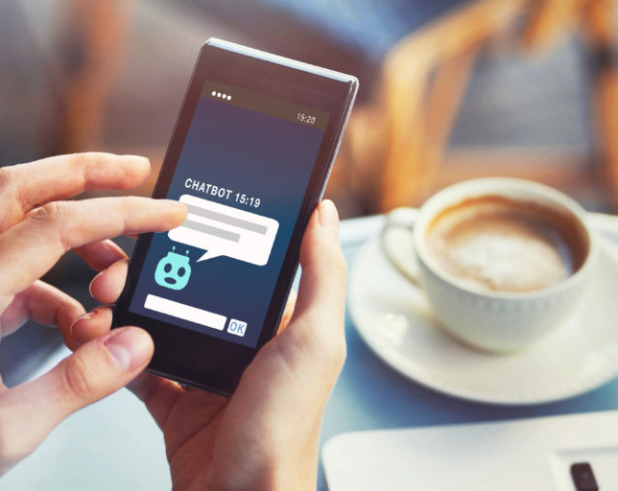
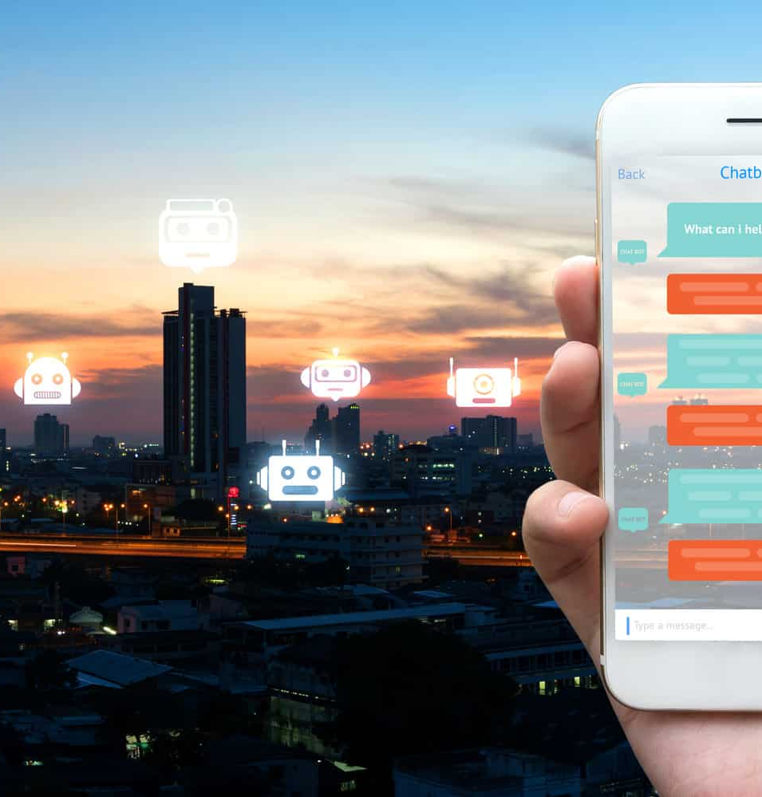
Designing and Developing a Python Chatbot
The development process for a Python chatbot involves several stages, from planning and design to testing and deployment.

Slide 9

Github Link:

Slide 10


Thank You!
PAGE
10

